Slide 1
Kinetic
Art
names

Slide 2
IDEA 1
01
IDEA 2
02
IDEA 3
03
TABLE OF CONTENTS
Here you could describe the topic of the section
Here you could describe the topic of the section
Here you could describe the topic of the section

Slide 3
0X
FOURIER DISPLAY

Slide 4
FOURIER
DISPLAY

Slide 5
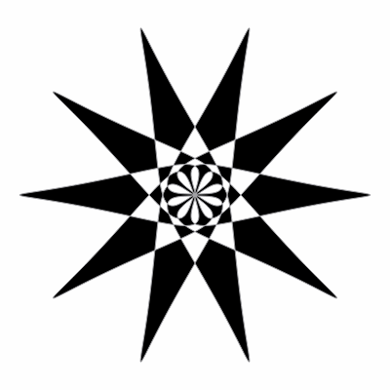
OVERVIEW
⟶ Every 1D or 2D signal can be broken down into epicycles (spinning circles) ⟵
⟶ Applications: Audio processing, image compression, differential equations, optics, radio astronomy… ⟵
⟶ Fourier series and transforms are tough concepts to grasp ⟵
⟶ The results are beautiful ⟵
Let’s Make One!

Slide 6
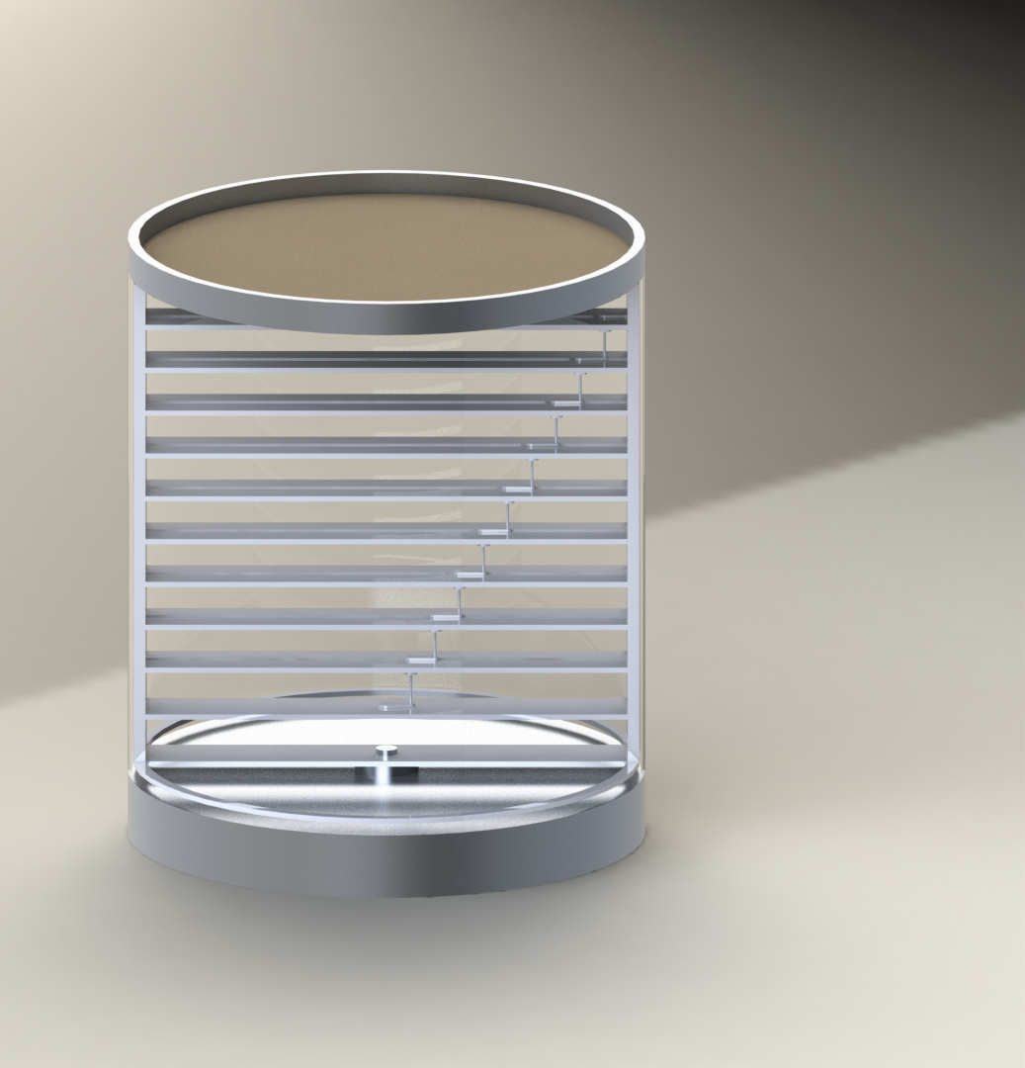
CONCEPT
“SISYPHUS” TABLE TOP
Ball bearing draws pattern in the sand.
GlASS ENCLOSURE
Supports stationary top
ROTATING FRAME
Rotates relative to the base
Allows the rotators to move radially
ROTATORS
Independent frequency and amplitude (length)
Positions add to create desired pattern
METAL BASE
Stationary; drives rotating frame

Slide 7
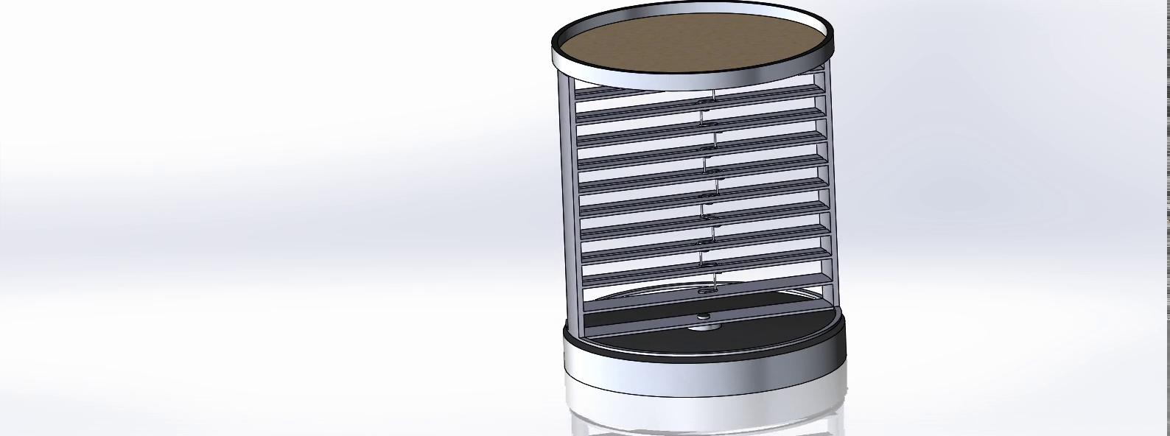
ANIMATION

Slide 8
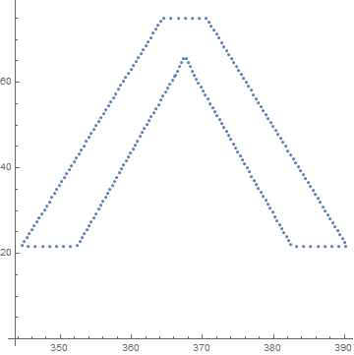
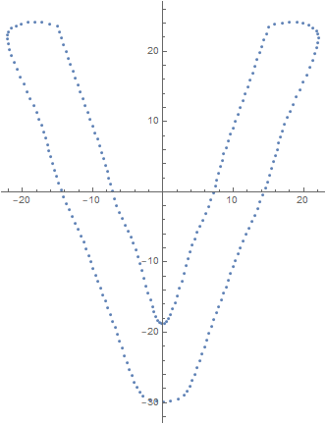
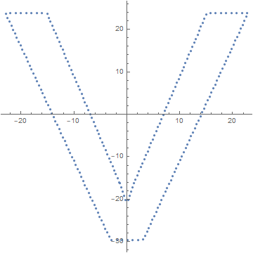
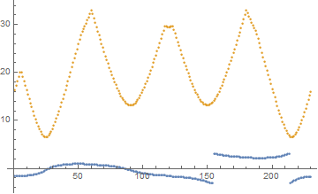
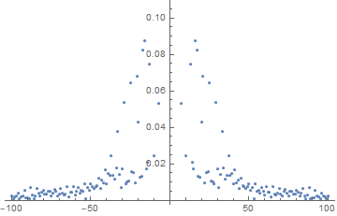
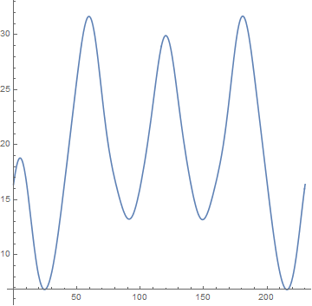
THE MATH
V

Slide 9
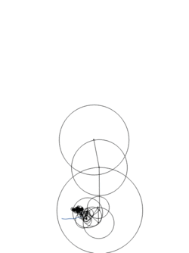
THANKS!
any questions?

Slide 10




CHALLENGES
MECHANISM
MANUFACTURING
PROGRAMMING
AESTHETICS
Tight tolerances
Gears and linkages
Limited tools
It’s gotta look good!
Quiet operation
Lots of moving parts
Power/signal transmission
Space/cost constraints
Algorithm Optimization
(Minimize epicycles)
Reliability

Slide 11
2nd ANNOUNCEMENT
MARS
Despite being red, Mars is a cold place, not hot
NEPTUNE
Neptune is the farthest planet from the Sun, the fourth-largest in our Solar System
JUPITER
SATURN
It’s a gas giant and the biggest planet in our Solar System
Saturn is a gas giant, composed of hydrogen and helium

Slide 12
02
IN DEPTH
You can enter here the subtitle if you need it

Slide 13

IN DEPTH
MERCURY
Mercury is the closest planet to the Sun and the smallest one in the Solar System—it’s only a bit larger than our Moon. The planet’s name has nothing to do with the liquid metal, since it was named after the Roman messenger god, Mercury

Slide 14
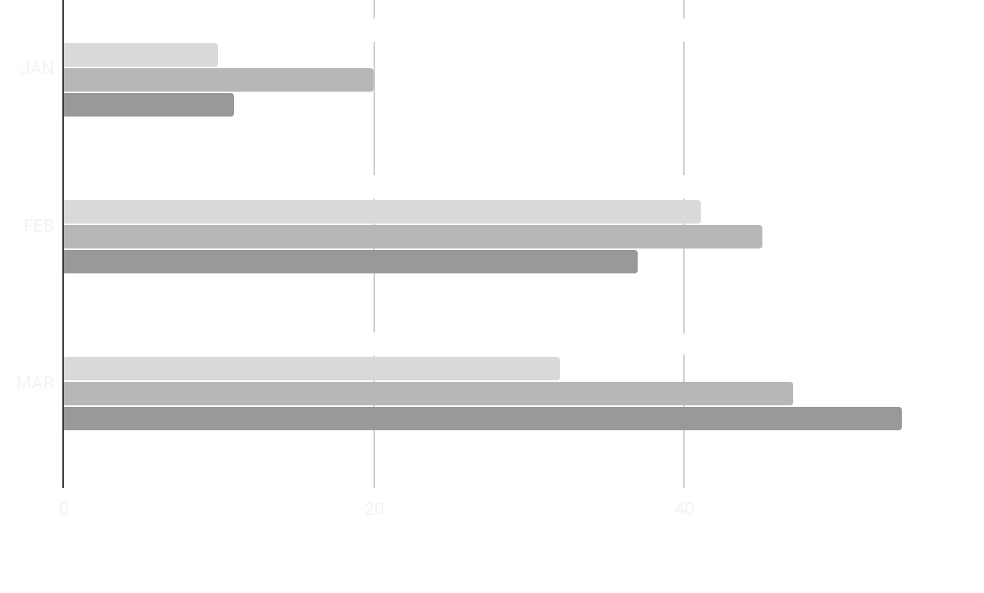
IN DEPTH
MARS
MERCURY
VENUS
JUPITER
VENUS
Venus has a beautiful name and is the second planet from the Sun. It’s terribly hot—even hotter than Mercury—and its atmosphere is extremely poisonous. It’s the second-brightest natural object in the night sky after the Moon
If you want to modify these graphs, click on them, follow the link, change the data and replace them

Slide 15
OUR NUMBERS
500
100
40
new clients last semester
ongoing projects
new employees last semester

Slide 16
SECTOR NEWS
VENUS
MARS
SATURN
Despite being red, Mars is a cold place, not hot. It’s full of iron oxide dust, which gives the planet its reddish cast
Venus has a beautiful name and is the second planet from the Sun. It’s terribly hot, even hotter than Mercury
Yes, this is the ringed one. It’s a gas giant, composed mostly of hydrogen and helium. It’s named after the Roman god of wealth and agriculture

Slide 17
03
IN BRIEF
You can enter here the subtitle if you need it

Slide 18
NEWS
NEPTUNE
MARS
MERCURY
JUPITER
VENUS
SATURN
Neptune is the farthest planet from the Sun and the fourth-largest in our Solar System
Despite being red, Mars is a cold place, not hot. It’s full of iron oxide dust, which gives the planet its reddish cast
Mercury is the closest planet to the Sun and also the smallest one in our Solar System
Jupiter is the biggest planet in our Solar System and also the fourth-brightest object in the sky
Venus has a beautiful name and is the second planet from the Sun. It’s terribly hot, even hotter than Mercury
Saturn is the ringed planet. It’s a gas giant, composed mostly of hydrogen and helium

Slide 19
CUSTOMER REVIEWS
RICHARD ROE
HELENA PATTERSON
“Neptune is the farthest planet from the Sun and the fourth-largest in our Solar System!”
“Despite being red, Mars is a cold place. It’s full of iron oxide dust, which gives the planet its reddish cast”

Slide 20
TABLE
 | ISSUE 1 | ISSUE 2 | ISSUE 3 | ISSUE 4
VENUS | 12 | 32 | 23 | 45
MERCURY | 67 | 23 | 45 | 65
MARS | 67 | 49 | 78 | 34

Slide 21
04
WELCOME!
You can enter here the subtitle if you need it

Slide 22




WELCOME!
MARY RUIZ
JOHN SMITH
JONATHAN DOE
MINA HAWKINS
Neptune is the farthest planet from the Sun and the fourth-largest in our Solar System
Despite being red, Mars is a cold place, not hot. It’s full of iron oxide dust, which gives the planet its reddish cast
Mercury is the closest planet to the Sun and the smallest one in our Solar System
Venus has a beautiful name and is the second planet from the Sun. It’s terribly hot, even hotter than Mercury

Slide 23
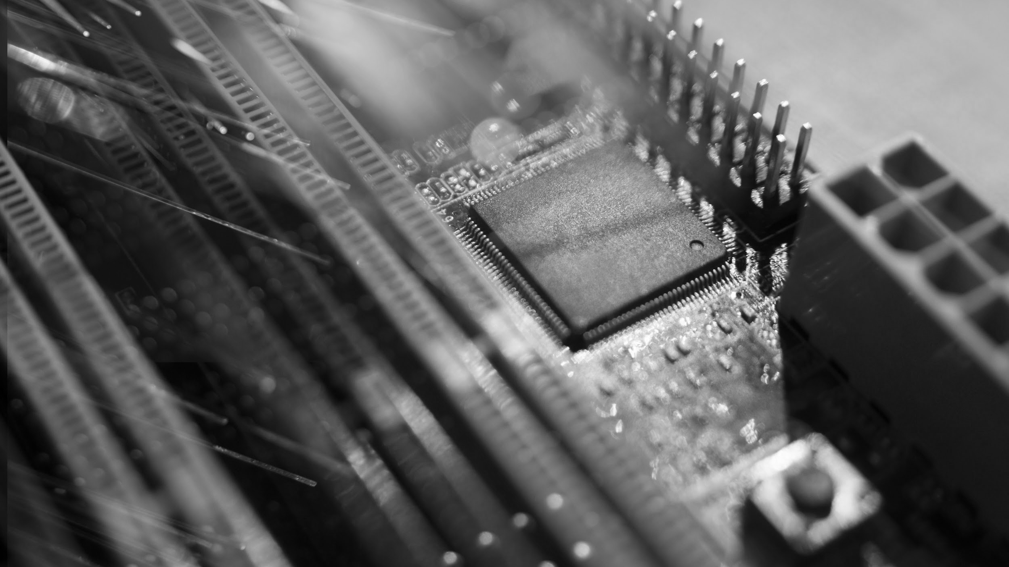
AWESOME WORDS

Slide 24
05
EVENTS
You can enter here the subtitle if you need it

Slide 25
REVIEW OF PAST EVENTS
Despite being red, Mars is a cold place, not hot
Jupiter is the biggest planet in our Solar System
FEB 02
APR 16
JAN 14
MAR 10
MAY 30
Mercury is the closest planet to the Sun
Saturn is composed of hydrogen and helium
Neptune is the farthest planet from the Sun

Slide 26
UPCOMING EVENTS
SEP 08
Mercury is the closest planet to the Sun
NOV 29
Saturn is composed of hydrogen and helium
OCT 16
Despite being red, Mars is a cold place, not hot
DEC 10
Jupiter is the biggest planet in our Solar System

Slide 27
06
SNEAK PEEK
You can enter here the subtitle if you need it

Slide 28



SNEAK PEEK
Neptune is the farthest planet from the Sun and the fourth-largest in our Solar System

Slide 29
RESOURCES
Did you like the resources on this template? Get them for free at our other websites.
VECTORS
Technology background with gradient colors
Blue 5g concept background
Abstract landing pages with technology devices
PHOTOS
Woman using smartphone with hologram
Happy businesswoman looking at camera with holding pencil and diary
Portrait of smiling man holding digital tablet looking at camera
Smiling bearded man holding disposable coffee cup while opening door
Portrait of pretty woman holding laptop looking at camera
Motherboard with optical fiber

